Slide 1
CROSS-EXAMINATION
Adam Constable QC

Slide 2
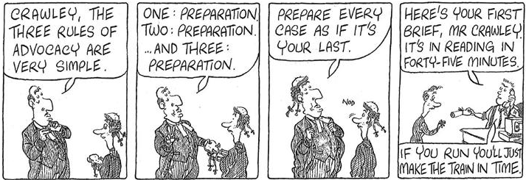
1. Preparation
Notes:
Judgment: Feb 18. Coulson J’s last hurrah
JCT contract: S&T engaged to design and construct a Premier Inn at Heathrow.
3 Adjudications between parties.
3rd adjudication decision: Grove’s PLN in response to interim application 22 was invalid: S&T prima facie entitled to £14m.
S&T sought to enforce. Grove issued Part 8 proceedings seeking various declarations.
4 issues for court to determine (A– D).
Most important for the industry: Issue C.
Take this case at some length because it is a long, detailed judgment which is important to have a feel for in future disputes.

Slide 3
Preparation contd…
“If you confront anyone who has lied with the truth, he will usually admit it - often out of sheer surprise. It is only necessary to guess right to produce your effect.”
― Agatha Christie, Murder on the Orient Express
Sadly only partly true… Don’t guess.
Notes:
Judgment: Feb 18. Coulson J’s last hurrah
JCT contract: S&T engaged to design and construct a Premier Inn at Heathrow.
3 Adjudications between parties.
3rd adjudication decision: Grove’s PLN in response to interim application 22 was invalid: S&T prima facie entitled to £14m.
S&T sought to enforce. Grove issued Part 8 proceedings seeking various declarations.
4 issues for court to determine (A– D).
Most important for the industry: Issue C.
Take this case at some length because it is a long, detailed judgment which is important to have a feel for in future disputes.

Slide 4
2. Case Theory
Start (and end) with case theory
What evidence do you want to quote in the closing submission?
Cross examine only insofar as necessary to advance your case theory
Don’t ask ANY question unless your case theory demands it.
Notes:
Reasons 1 and 2: context to the meat of Coulson J’s analysis

Slide 5
3. Putting your case
You must ‘put your case’.
‘Your case’ is the key aspects required by your case theory
It is NOT every pleaded issue/issue on the evidence
It is NOT governed by the evidence your witnesses have given (unless it coincides with your case theory)
YOU can choose who to put your case to. Generally, don’t have to put every point to everyone, but don’t avoid obviously relevant witnesses.
Prepare with flexibility
Notes:
Reason 4: words specific to that JCT contract: will not always be the case

Slide 6
4. Documents are your (only) weapon of choice
Delay cases: fully on top of chronological bundle is key
BEFORE starting XX prep, note up bundle
Excel, Tables, Notes etc. Searchable document [Start with bundle index?]
Which witnesses relate to which document?
Cross ref documents to the reply to the document
Which (other) witness might you put the document to (take care)?
Notes:
Reason 4: words specific to that JCT contract: will not always be the case

Slide 7
5. Witness handling generally
Everyone develops their own style but….
Are you likely to ‘win’ the XX?
Bad points which you have to challenge – get in and out asap;
Don’t be aggressive on points you are (probably) wrong about;
Be aware of your tribunal
Court v arbitration
Common law v civil law
Fact v expert
Different styles get different results: BE FLEXIBLE
Notes:
Reason 4: words specific to that JCT contract: will not always be the case

Slide 8
6. Witnesses – preparing the shape of the XX
Which witnesses? Do I need to ask anything?
You are in charge of the agenda; the statement/report is not the agenda.
A witnesses’ real contribution to the case may come from the documents but be ignored in the statement/report
What do I need to challenge in the statement/report?
What evidence do I want to extract through XX on documents?
Notes:
Reason 4: words specific to that JCT contract: will not always be the case

Slide 9
7. Witnesses – next level of preparation
“Cross-examination is the greatest legal engine ever invented for the discovery of truth. You can do anything with a bayonet except sit on it. A lawyer can do anything with cross-examination if he is skillful enough not to impale his own cause upon it.” John Henry Wigmore
The ORDER of TOPICS can be important:
Start strong v leave best to last.
Chronological?
The ORDER of QUESTIONS can be critical:
Documents then statement, or statement then documents?
‘Ringfence’
Do you want the statement to be the truth, or the document? [Case Theory]
NO right answer, but you must PLAN YOUR STRATEGY.
Notes:
Reason 4: words specific to that JCT contract: will not always be the case

Slide 10
7. Witnesses – granular preparation and execution
Writing out questions in full v direction of travel/x-ref?
Writing out questions in full is sometimes essential.
Think about written closing submissions
Precision can be key
Flexibility is always essential
Listen to the answers
Did you get quite enough…?
Are you going to WIN the point if you pursue it?
Notes:
Reason 4: words specific to that JCT contract: will not always be the case

Slide 11
8. Particularities of Expert Witnesses
Qualifications/experience (be careful)
Instructions
Do you have them?
Have the instructions led to the answer?
Challenge the expert on their factual assumptions…
What factual assertions/assumptions have been made?
Change the assumption, change the facts
Think about your XX of the expert when preparing the XX of the factual witness
Make sure you take the Tribunal with you (start with the basics…)
Credibility v Substance….?
A
Notes:
Reason 4: words specific to that JCT contract: will not always be the case

Slide 12
9. Know when to stop
That’s it….
You won’t always get it right… but you’ll know when you have got it wrong
Generally less is more
Notes:
Reason 4: words specific to that JCT contract: will not always be the case

Slide 13
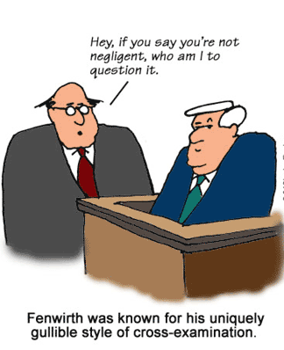
Thanks for listening….

Slide 14
Adam Constable QC
Thanks for listening

