Slide 1
Methods of Delay Analysis
14 November 2018

Slide 2
Methods of Delay Analysis
Presentation by Blackrock Expert Services
Mahmoud Abdelaal

Slide 3
Who Are We?
Blackrock Expert Services is a leading specialist professional consultancy providing high quality expert witness, tribunal and construction consulting services to the global market.
We have the largest pool of independent expert witnesses and specialist support staff in the market:
25 experts with over 450 years of collective experience;
110 full-time members of staff across London, Preston, Dubai, and Paris;
Analysis provided on over 300 projects;
^{17 different nationalities;}
Speaking a collective 20 languages; and
Wide ranging experience including civil engineering, architecture, mechanical engineering, electrical engineering, chemical engineering, naval architecture, industrial engineering, quantity surveying, and geology.
Independent expert witness services on construction disputes:
^{Programming;}
^{Quantum; and}
Project Manager / Construction Manager performance.
^{Tribunal services:}
^{Arbitrator;}
^{Mediator;}
Dispute Adjudication Board (DAB);
^{Adjudicator; and}
^{Neutral Evaluator.}
Construction consulting services:
^{Planning & programming;}
^{Project Management;}
^{Procurement advice;}
Project Controls training and development;
^{Value engineering;}
^{Risk assessment; and}
^{Project health checks.}
We are currently working on some of the most complex and iconic construction projects in the world, with values up to £6bn.

Slide 4
Agenda
Introduction- what is delay analysis?
Methods of delay analysis
Comparing different methods of delay analysis

Slide 5
Introduction
Some Context
Construction is complex and projects are unique. Careful planning is key
Programme is a tool to plan, and monitor, not a tool to make client happy
Perfect programme would show:
Logistics;
Who should create the programme in order to achieve these criteria?
Sequence;
Realistic logic links;
Resources;
Clear critical path; and
Importantly a strategy

Slide 6
Introduction
Work programmes can be as simple as few bar charts
2017
2018
2019
Dec
Jan
Feb
Mar
Apr
May
Jun
Jul
Aug
Sep
Oct
Nov
Dec
Jan
Design
Procurement
Construction

Slide 7
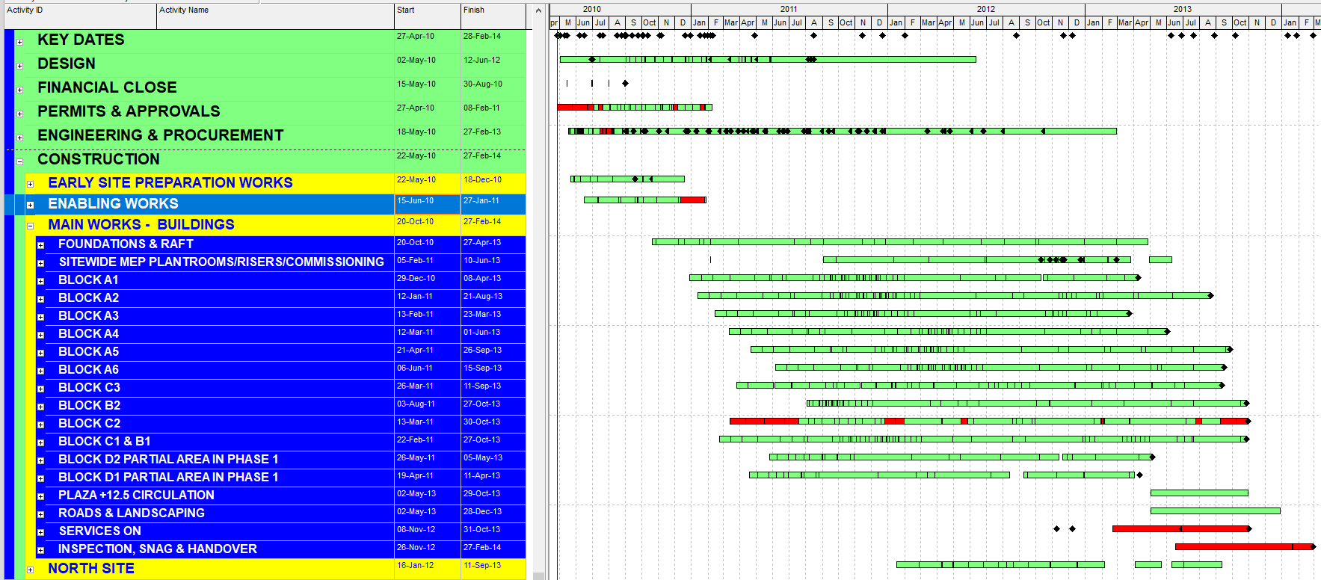
Introduction
Or a complex schedule prepared in a specialist software
Do NOT CREATE A MONSTER

Slide 8
Introduction
What is Delay Analysis?
2015
2016
2017
Dec
Jan
Feb
Mar
Apr
May
Jun
Jul
Aug
Sep
Oct
Nov
Dec
Jan
Feb
Mar
Apr
1- What were the critical activities (ideally at every point in time)?
i.e. incidence / effect of delay
Design
Design
Procurement
Procurement
Construction
Construction
3 Months Delay
No delay
5 days
15 days
20 days
50 days
2- Extent of delay, how incrementally was incurred?
No delay
5 days
20 days
40 days
90 days
No delay
Paperwork
Design Changes
Custom issues
Lack of res.
3- Causes of delay

Slide 9
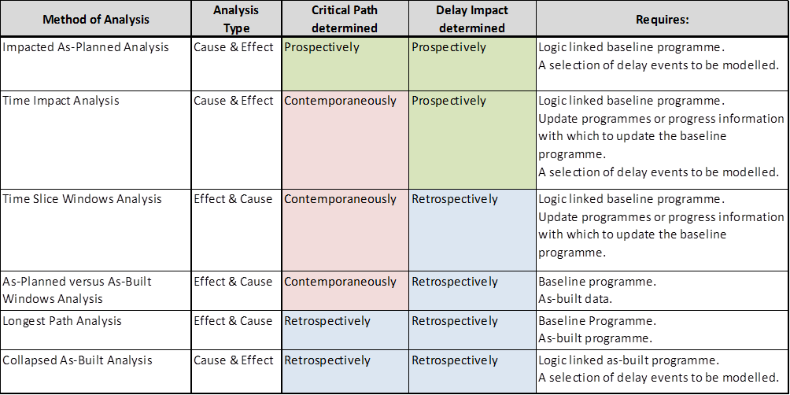
Methods of Delay Analysis
SCL Delay and Disruption Protocol 2nd edition

Slide 10
Methods of Delay Analysis
Identification of Delay Impact
Key Rule:
Never rely on assumptions when you know the facts
Delay event
After event
Time of undertaking analysis
Project Period
PC
Time of undertaking analysis
Dispute Period
Retrospective:
Calculate the actual extent and identify cause of delay
After the event
Claim preparation
Dispute resolution (expert analysis)
Prospective:
Estimate the potential impact of a delay event
Ideal to undertake during currency of project to avoid dispute
Contract requirement (e.g. NEC)

Slide 11
Methods of Delay Analysis
Identification of Critical Path
Prospective: critical path is identified using planned programme (i.e. baseline)
Retrospective: critical path is identified using as-built programme or records
Contemporaneous: critical path is identified using the contemporaneous records and knowledge of parties as at the time being analysed

Slide 12
Methods of Delay Analysis
Type of Analysis
Typically, a contractor will seek to establish the effect of a delay event once an event is identified, i.e. cause and effect.
An independent expert should:
First establish the effect (i.e., establish whether the works were actually delayed and identify which activities led to that delay); and then
Seeks to establish the cause, i.e. effect and cause.

Slide 13
Methods of Delay Analysis
Ideal Delay Analysis Method?
If all factors allow the analyst to choose a method, then the ideal method should:
Identify the actual critical path contemporaneously
Identify the impact of delay retrospectively
Start from the effect and then establish the cause (effect and cause)

Slide 14
Methods of Delay Analysis
1. Impacted As-planned Analysis
This analysis requires the following information:
A logic-linked planned programme in its native electronic format; and
Sufficient as-built information, or understanding of the facts, to determine the duration of the delay events so that they may be modelled on the baseline programme.
Steps:
Step 1: establish the baseline programme.
Step 2: model the actual duration of the selected delay event and impact the as-planned programme.
Step 3: measure the change in completion date, which is said to be the critical delay caused by each delay event.
Reasons to perform this type of analysis:
There is insufficient as-built progress information in order to understand what actually happened.
The delay event is relatively straightforward and occurs at or near the commencement of the works (i.e., delay to site access).
Common problems with this type of analysis:
This analysis requires a reasonable and fully logic-linked baseline programme. Any changes required to meet these criteria will be subjective and possibly open to criticism.
This analysis provides a prospective determination of the effect of the delay event which, if performed after the actual effects become known, may be inconsistent with what actually happened.
The results of this analysis are typically biased towards the party whose interest lies in maximising the impact of the delay event, as the introduction of any significant delay is likely to delay the completion date regardless if it is actually critical or not.
This analysis only considers selected delay events and may ignore other more critical delay events. In this regard, this analysis favours the party selecting the events to be modelled.
This type of analysis cannot be used to determine the existence of concurrent delays and/or their true effect on the critical path.
In summary, this type of analysis takes no account of progress, resources, changing logic and is unlikely to be reliable in dispute resolution.

Slide 15
Methods of Delay Analysis
1. Impacted As-planned Analysis
2018
May
Jun
Jul
Aug
Sep
Oct
B1 - Substructure
Planned baseline sequence typically shown by GREEN bars.
B1 - Superstructure
STEP 1 – Establish Baseline Programme
B2 - Substructure
B2 - Superstructure
Project Completion: 15 August
The Baseline programme with the planned sequence for the construction of buildings 1 and 2. This programme is the best representation of the contractor’s original planned intent.
B1 - Substructure
B1 - Superstructure
Float
STEP 2 – Model the impact of the selected delay event and impact the baseline programme
B2 - Substructure
Delay Event
Delay Event – Remedial works to B2 substructure caused 47 days of delay.
B2 - Superstructure
B2 - Superstructure
Project Completion: 15 August
Project Completion
STEP 3 – Measure Delay
Project Planned Completion Date | Impacted Planned Completion Date | Delays due to the Delay Event
15-Aug | 01-Oct | 47
47 days of critical delay

Slide 16
Methods of Delay Analysis
2. Time Impact Analysis
This analysis requires the following information:
The logic-linked planned programme in its native electronic format produced prior to the effective, or start, date of the delay event being measured.
Reliable and consistent progress data, in sufficient detail and at small enough intervals to make the analysis meaningful.
The anticipated programming impact of the delay event as at the effective, or start, date of delay event being modelled.
Steps:
Step 1, note the logic-linked planned programme.
Step 2, note the planned completion date within the planned programme which immediately precedes the effective, or start, date of the delay event being measured having taken account of progress.
Step 3, produce a model of the anticipated impact of the delay event being measured (sometimes referred to as a ‘fragnet’).
Step 4, incorporate the delay event model into the accepted programme and measure any resulting change in the anticipated completion date. The change in the anticipated completion date is said to be the critical delay caused by the delay event.
Reasons to perform this type of analysis:
The analysis is most reliable if performed immediately after the parties became aware of a delay event but do not yet know the eventual impact of the event.
This method of analysis is prescribed within the NEC form of construction contracts.
Common problems with this type of analysis:
This analysis relies on a prospective determination of the effect of the modelled delay event which, if performed after the actual effects become known, may be inconsistent with what actually happened.
This analysis only considers selected delay events and may ignore other more critical delay events (i.e., it is a cause and effect approach). In this regard time impact analysis favours the party selecting the events to be modelled.
This analysis requires a reliable fully logic-linked planned programme in its native electronic format which was produced immediately prior to the delay event, which may not be available.

Slide 17
Methods of Delay Analysis
2. Time Impact Analysis
2018
May
Jun
Jul
Aug
Sep
Oct
STEP 1 – Baseline Programme
B1 - Substructure
B1 - Superstructure
B2 - Substructure
B2 - Superstructure
Project Completion
Start Date of the Delay Event 15 June
B1 - Substructure
STEP 2 – Planned Programme Immediately Before Delay Event
B1 - Superstructure
B2 - Substructure
As-built sequence typically in BLUE.
B2 - Superstructure
Project Completion
STEP 3 – Model Effect of Delay Event (Anticipated 30 days of Remedial Work)
Delay Event
B1 - Substructure
STEP 4 – Incorporate Delay Events into Programme Update and Measure Change to Anticipated Completion Date
B1 - Superstructure
B2 - Substructure
Delay
B2 - Superstructure
B2 - Superstructure
Project Completion
Project Completion
An anticipated 30-day remedial works delay event caused 15 days of critical delay to completion.
STEP 2 Completion Date | STEP 4 Completion Date | Delays due to the Delay Event
31-Aug | 15-Sep | 15

Slide 18
Methods of Delay Analysis
3. Time Slice Windows Analysis
This analysis requires the following information:
An electronic version of the baseline programme in its native format;
A reliable and complete set of weekly or monthly programme updates in their native and electronic format; and
Sufficient as-built information to explain the causes of critical delay.
Steps:
Step 1, note the planned completion date within the baseline programme.
Step 2, note the critical path and the planned completion date within the first programme update. If the planned completion date is delayed during the period between the baseline and the first update, then the source of delay is determined by means of an analysis of the available as-built information.
Step 3, Step 2 is repeated between the first programme update and the second programme update, and is repeated for all subsequent updates until the final as-built programme.
Reasons to perform this type of analysis:
This analysis is based on the programme updates which, if reliable, provide the most comprehensive set of planning information.
Besides the as-planned versus as-built windows method, this is the only other analysis method which enables determination of the contemporaneous critical path, the effect of the delay events retrospectively, and is consistent with the effect and cause approach.
Common problems with this type of analysis:
This analysis heavily relies on the programme updates, which are often found to be unreliable for a number of reasons. Contractors will often use programme updates as a commercial tool to artificially establish an entitlement to an extension of time. The level of care and bi-party review is not always provided for the updates to the same extent as to the baseline programme.

Slide 19
Methods of Delay Analysis
3. Time Slice Windows Analysis
2018
May
Jun
Jul
Aug
Sep
Oct
Critical path typically shown in RED.
B1 - Substructure
STEP 1 – Baseline Completion Date
B1 - Superstructure
B2 - Substructure
B2 - Superstructure
Project Completion
Delay
B1 - Substructure
B1 - Superstructure
STEP 2 – Update 1 Planned Completion
B2 - Superstructure
B2 - Superstructure
Update 1 – Planned Completion Date 6 September (22 days of delay)
Project Completion
An analysis of the project’s facts on 1 July:
Lack of access to Building 1 caused 22 days to the start of the Building 1 works.
Building 1 was critically driving project completion at the start and end of the window.
The anticipated project completion date was delayed by 22 days
The lack of access to Building 1 caused 22 days of critical delay to completion.

Slide 20
Methods of Delay Analysis
3. Time Slice Windows Analysis
2018
May
Jun
Jul
Aug
Sep
Oct
Delay
re
B1 - Substructure
STEP 2 – Update 1 Planned Completion
B1 - Superstructure
Update 1 – Planned Completion Date 6 September
B2 - Substructure
B2 - Superstructure
Project Completion
Delay
B1 - Substructure
B1 - Superstructure
Update 2 – Planned Completion Date 1 October (25 days later than update 1)
STEP 2a – Update 2 Planned Programme
B2 - Substructure
B2 - Substructure
B2 - Superstructure
Project Completion
An analysis of the project’s facts on 1 August:
It took 47 days to perform remedial works on Building 2 foundations.
Building 1 was critically driving project completion at the start of the window.
Building 2 was critically driving project completion at the end of the window.
The anticipated project completion date was delayed by 25 days in the window.
Accordingly, the 47-day remedial works delay event pushed Building 2 onto the critical path and caused 25 days of critical delay

Slide 21
Methods of Delay Analysis
3. Time Slice Windows Analysis
2018
May
Jun
Jul
Aug
Sep
Oct
Delay
B1 - Substructure
STEP 2a – Update 2 Planned Programme
B1 - Superstructure
Update 2 – Planned Completion Date 1 October
B2 - Substructure
B2 - Substructure
B2 - Superstructure
Project Completion
Delay
B1 - Substructure
STEP 2b – Update 3 Planned Programme
B1 - Superstructure
B2 - Substructure
B2 - Substructure
B2 - Substructure
B2 - Superstructure
Project Completion
Update 3 – Planned Completion Date 1 October (no delay)
An analysis of the project’s facts on 1 September:
There was no change in the planned completion date between updates 2 and 3.
Accordingly, there was no critical delay in the window.
DELAY AND QUANTUM

Slide 22
Methods of Delay Analysis
3. Time Slice Windows Analysis
2018
May
Jun
Jul
Aug
Sep
Oct
STEP 2b – Update 3 Planned Programme
Delay
B1 - Substructure
B1 - Superstructure
Delay
B1 - Superstructure
B2 - Substructure
B2 - Substructure
B2 - Substructure
B2 - Superstructure
Update 3 – Planned Completion Date 1 October (no delay)
Project Completion
STEP 2c – Update 4 Planned Programme (As-Built)
Delay
B1 - Substructure
B1 - Superstructure
Delay
B1 - Superstructure
B2 - Substructure
B2 - Substructure
B2 - Superstructure
Project Completion
Update 4 – Completion Date 1 October (no delay)
WINDOW | DELAY EVENT | EXTENT OF DELAY
1 | Lack of access to Building 1 | 22
2 | Remedial works on Building 2 foundations | 25
 | TOTAL DELAY | 47
An analysis of the project’s facts on 1 October:
There was no change in the planned completion date between updates 3 and 4.
Accordingly, there was no critical delay in the window.
DELAY AND QUANTUM

Slide 23
Methods of Delay Analysis
4. As-planned versus As-built Windows Analysis
This analysis requires the following information:
Baseline programme;
As-built programme;
Sufficient as-built information, or understanding of the facts, to determine the actual critical path; and
Sufficient as-built information to explain the causes of critical delay.
Steps:
Step 1, establish the baseline programme.
Step 2, establish the as-built programme and the actual critical path through an analysis of the project’s facts and practical experience.
Step 3, divide the actual critical path into windows of time which represent a single critical activity or a discrete set of critical activities.
Step 4, measure the extent of delay incurred at the start and end of each window by reference to the baseline programme.
Step 5, calculate the extent of delay incurred in each window and examine the project records in order to determine the causes of delay.
Reasons to perform this type of analysis:
The programme updates are too few or unreasonable, thereby preventing their use for a time slice windows method of delay analysis.
Besides the time slice windows method, this is the only method of analysis which determines the critical path contemporaneously, the effect of the delay events retrospectively and is consistent with the effect and cause approach.
Common problems with this type of analysis:
Unreasonable assumptions in the baseline programme can lead to unreasonable results.
The analysis supporting the determination of the critical path is not sufficiently robust.
Project records may be inadequate to accurately determine the causes of delay.
DELAY AND QUANTUM

Slide 24
Methods of Delay Analysis
4. As-planned versus As-built Windows Analysis
2018
May
Jun
Jul
Aug
Sep
Oct
STEP 1 – Establish Baseline
B1 - Substructure
B1 - Superstructure
B2 - Substructure
B2 - Superstructure
Project Completion
B1 - Substructure
STEP 2 – Establish As-built Programme and Critical Path
B1 - Superstructure
Float
B2 - Superstructure
Project Completion
An analysis of the project’s facts and practical experience leads to the following critical path conclusions:
1 June – 7 July, the critical path starts in building 1’s substructure because it was delayed while building 2 was not.
7 July, the critical path switched to building 2’s substructure due to its continuing substructure delays and starting building 1’s superstructure ahead of the planned sequence.
7 July – 1 October, the critical path is maintained in building 2’s substructure and superstructure sequence as it drives project completion
DELAY AND QUANTUM

Slide 25
Methods of Delay Analysis
4. As-planned versus As-built Windows Analysis
2018
May
Jun
Jul
Aug
Sep
Oct
B1 - Substructure
STEP 3 – Establish Windows
B1 - Superstructure
Float
B2 - Substructure
B2 - Superstructure
Window 1
Window 2
Window 3
Window 4
Project Completion
Divide the actual critical path into windows of time which represent a single critical activity/event or a discreet set of critical activities/events.
WINDOW | START | END | CRITICAL WORKS
1 | 01-Jun | 23-Jun | Delay to start of building 1 substructure
2 | 23-Jun | 07-Jul | Building 1 substructure works
3 | 07-Jul | 30-Jul | Continuing delay to completion of building 2 substructure
4 | 30-Jul | 01-Oct | Building 2 superstructure
DELAY AND QUANTUM

Slide 26
Methods of Delay Analysis
4. As-planned versus As-built Windows Analysis
2018
May
Jun
Jul
Aug
Sep
Oct
A
B1 - Substructure
STEP 4 – Measure Delay
B
B1 - Superstructure
C
B2 - Substructure
D
B2 - Superstructure
E
Project Completion
A
B
B1 - Substructure
B1 - Superstructure
Float
B2 - Substructure
C
D
B2 - Superstructure
Window 1
Window 2
Window 3
Window 4
Project Completion
E
WINDOW MILESTONE DATES | PLAN DATE | ACTUAL DATE | DELAY
Start Works | 01-Jun | 01-Jun | 0
Start B1 Substructure | 01-Jun | 23-Jun | 22
Finish B2 Substructure Planned Works | 15-Jun | 07-Jul | 22
Start B2 Superstructure | 15-Jun | 01-Aug | 47
Project Completion | 15-Aug | 01-Oct | 47
A
B
C
D
E
DELAY AND QUANTUM

Slide 27
Methods of Delay Analysis
4. As-planned versus As-built Windows Analysis
2018
May
Jun
Jul
Aug
Sep
Oct
STEP 5 – Calculate and Determine the Causes of Critical Delays
B1 - Substructure
B1 - Superstructure
B2 - Substructure
Delay Event 1 – Lack of access to building 1 caused 22 days of critical delay.
B2 - Superstructure
Project Completion
B1 - Substructure
B1 - Superstructure
B2 - Substructure
Float
Delay Event 2 – Lack of access to building 2 caused 25 days of critical delay.
B2 - Superstructure
Project Completion
WINDOW | DELAY AT START | DELAY AT END | DELAY IN WINDOW | CAUSES OF DELAY
1 | 0 | 22 | 22 | Lack of access to building 1
2 | 22 | 22 | 0 | -
3 | 22 | 47 | 25 | Remedial works to building 2
4 | 47 | 47 | 0 | -
 |  |  | 47 | TOTAL DELAY
DELAY AND QUANTUM

Slide 28
Methods of Delay Analysis
5. Longest Path Analysis
This analysis requires the following information:
Baseline programme;
As-built programme;
Sufficient as-built information, or understanding of the facts, to determine the as-built critical path; and
Sufficient information to explain the causes of critical delay.
Steps:
Step 1, establish the as-built critical path by tracing the driving sequence of events backwards from completion.
The next steps are the same as outlined in the as-planned versus as-built windows analysis.
Reasons to perform this type of analysis:
The programme updates are too few or unreasonable, thereby preventing their use in a time slice windows method of delay analysis.
Common problems with this type of analysis:
This analysis relies on a retrospective determination of the critical path which does not allow for switches in the critical path. Large complex construction projects often experience several critical path changes during the progress of the works.
This analysis does not allow for switches in the as-built critical path. Explaining a switch in the actual critical path as part of an as-planned versus as-built windows analysis can be difficult.
This type of analysis cannot be used to determine the existence of concurrent delays and/or their true effect on the critical path.
DELAY AND QUANTUM

Slide 29
5. Longest Path Analysis
2018
May
Jun
Jul
Aug
Sep
Oct
Delay
B1 - Substructure
STEP 1 – Establish As-built Critical Path
B1 - Superstructure
Delay
B1 - Superstructure
B2 - Substructure
B2 - Substructure
Float
Follow the longest sequence backwards to establish the as-built critical path.
B2 - Superstructure
Project Completion
The Longest Path Analysis leads to the following critical path conclusions:
1 June – 31 July, the critical path starts in building 2’s substructure.
1 August – 1 October, the critical path continues in building 2’s superstructure until the completion of the project.
B1 - Substructure
B1 - Superstructure
STEP 2 – Establish Baseline
B2 - Substructure
B2 - Superstructure
Project Completion
The Baseline programme with the planned sequence for the construction of buildings 1 and 2. This programme is the best representation of the contractor’s original planned intent.
DELAY AND QUANTUM

Slide 30
Methods of Delay Analysis
5. Longest Path Analysis
2018
May
Jun
Jul
Aug
Sep
Oct
Delay
B1 - Substructure
STEP 3 – Establish Windows
B1 - Superstructure
Delay
B1 - Superstructure
B2 - Substructure
B2 - Substructure
Float
B2 - Superstructure
Window 1
Window 2
Window 3
Project Completion
WINDOW | START | END | CRITICAL ACTIVITIES
1 | 01-Jun | 15-Jun | Substructure of Building 2
2 | 15-Jun | 01-Aug | Delays in the Substructure of Building 2
3 | 01-Aug | 01-Oct | Superstructure of Building 2
DELAY AND QUANTUM

Slide 31
Methods of Delay Analysis
5. Longest Path Analysis
2018
May
Jun
Jul
Aug
Sep
Oct
A
B1 - Substructure
B
B1 - Superstructure
B2 - Substructure
C
B2 - Superstructure
D
Project Completion
Delay
B1 - Substructure
STEP 4 – Measure Delay
B1 - Superstructure
Delay
B1 - Superstructure
A
B
C
Float
B2 - Substructure
B2 - Substructure
B2 - Superstructure
Window 1
Window 2
Window 3
Project Completion
D
WINDOW MILESTONE DATES | PLAN DATE | ACTUAL DATE | DELAY
Start Works | 01-Jun | 01-Jun | 0
Finish B2 Substructure | 15-Jun | 15-Jun | 0
Finish B2 Substructure Remedial works | 15-Jun | 01-Aug | 47
Project Completion | 15-Aug | 01-Oct | 47
A
B
C
D

Slide 32
Methods of Delay Analysis
5. Longest Path Analysis
2018
May
Jun
Jul
Aug
Sep
Oct
B1 - Substructure
B1 - Superstructure
B2 - Substructure
B2 - Superstructure
Project Completion
STEP 5 – Measure and Determine the Causes of Critical Delays
Delay
B1 - Substructure
B1 - Superstructure
Delay
B1 - Superstructure
B2 - Substructure
B2 - Substructure
Float
Delay Event – Remedial works to B2 substructure caused all of the 47 days of critical delay to completion.
B2 - Superstructure
Window 1
Window 2
Window 3
Project Completion
WINDOW | DELAY AT START | DELAY AT END | DELAY IN WINDOW | CAUSES OF DELAY
1 | 0 | 0 | 0 | -
2 | 0 | 47 | 47 | Remedial works to building 2 substructure
3 | 47 | 47 | 0 | -
 |  |  | 47 | TOTAL DELAY

Slide 33
Methods of Delay Analysis
6. Collapsed As-built Analysis
This analysis requires the following information:
An as-built programme including as-built logic; and
Sufficient as-built information to explain how the delay event(s) being modelled affected the as-built programme.
Steps:
Step 1, establish a comprehensive logic-linked as-built programme by reference to project records.
Step 2, identify the delay event in question on the as-built programme.
Step 3, remove the selected delay event from the as-built programme and calculate the change or “collapse” in the project’s completion date, if any. The extent of the change in the completion date represents the critical delay caused by the modelled delay event.
Reasons to perform this type of analysis:
There is no baseline programme, thereby preventing the use of several of the other types of methods of delay analysis.
The logic behind this analysis is straightforward. A collapsed as-built analysis sets out what might have happened had the delay event not occurred.
Common problems with this type of analysis:
The results of this analysis are predicated on a hypothetical model. Removing an event which actually happened from the as-built programme presents a situation which never actually happened.
The results of this analysis are typically biased towards the party whose interest lies in minimising the impact of the delay event, as the changed completion date will typically collapse back to the next most delayed sequence.
Establishing a comprehensive logic-linked as-built programme is typically a forensic and subjective exercise which is likely to face heavy scrutiny/criticism by the other party.
This method allows the analyst to assess as many or as few events as desired (i.e., it is a cause and effect approach). Modelling a limited number of selected events can provide a biased result.
This type of analysis cannot be used to determine the existence of concurrent delays and/or their time effect on the critical path.

Slide 34
Methods of Delay Analysis
6. Collapsed As-built Analysis
2018
May
Jun
Jul
Aug
Sep
Oct
B1 - Substructure
STEP 1 – Establish As-built programme and logic
B1 - Superstructure
B2 - Substructure
Float
B2 - Superstructure
Project Completion
B1 - Substructure
STEP 2 – Identify a selected delay event
B1 - Superstructure
B2 - Substructure
B2 - Substructure
Float
Delay Event – Remedial works to building 2 substructure
B2 - Superstructure
Project Completion
B1 - Substructure
21-day improvement to Project Completion (10 September from 1 October), so the delay event is said to have caused 21 days of critical delay.
STEP 3 – Remove selected delay events and measure effect of delay
B1 - Superstructure
B2 - Substructure
B2 - Substructure
B2 - Substructure
B2 - Superstructure
Remove delay event and collapse back programme
Project Completion
Project Completion

Slide 35
Methods of Delay Analysis
Summary
METHOD OF DELAY ANALYSIS | Impact As-Planned | Time Impact | Time Slice | As-Planned v As-Built Windows | Longest Path | Collapsed As-Built
Lack of access to Building 1 | 0 | - | 22 | 22 | 0 | -
Remedial works to Building 2 foundations | 47 | 15 | 25 | 25 | 47 | 21
Total | 47 | - | 47 | 47 | 47 | -
Not all delay event impacts have been calculated for each method. Therefore, the “Remedial works to Building 2 foundations” in the red box is the most appropriate for comparative purposes.

Slide 36
Methods of Delay Analysis
Any Questions?

